Slide 1

Emotion Recognition from Audio Using Deep Learning
Under the guidance of -
Prof. Maximilian Schuhmacher
Dr. Simon Ziegler

Slide 2

MEET THE TEAM !
Gagan Gowda(11038582)
Revisha Vas(11038663)
Yamini Hari (11038083)
20.12.23
SRH Hochschule Heidelberg – Title

Slide 3
Overview of our project
01
20.12.23
SRH Hochschule Heidelberg – title

Slide 4
Objective
Develop a deep learning model to recognise emotions from audio recordings.
Human-Computer Interaction:
Enhances the ability of machines to understand and respond to human emotions, making interactions more natural and effective.
Mental Health:
Assists in monitoring and diagnosing mental health conditions by detecting emotional caused from speech patterns.
Personalisation:
Enables personalised experiences in applications such as virtual assistants, which can adapt responses based on the user's emotional state.
20.12.23
SRH Hochschule Heidelberg – Scientific Research, Writing and Presentation

Slide 5
Which dataset are we using?
02
20.12.23
SRH Hochschule Heidelberg – title

Slide 6

RAVDESS DATASET
The RAVDESS (Ryerson Audio-Visual Database of Emotional Speech and Song) dataset is a validated multimodal database.
Full dataset of speech and song, audio and video (24.8 GB).
Contains 1440 audio files: 60 trials per actor × 24 actors.
24 professional actors (12 female, 12 male), vocalising two statements in a neutral North American accent.
Emotions: neutral, calm, happy, sad, angry, fearful, surprise, and disgust.
Each emotion is produced at two levels of intensity (normal, strong), except for the neutral emotion.
20.12.23
SRH Hochschule Heidelberg – Scientific Research, Writing and Presentation

Slide 7
Technology Stack
03

Slide 8
LIBRARIES USED -
librosa for audio processing
torch and torchaudio for deep learning
matplotlib for plotting
numpy for numerical operations
tqdm for progress bars
Tensorboard for logging and visualisation

Slide 9
Data Preprocessing and Model Architecture
04

Slide 10

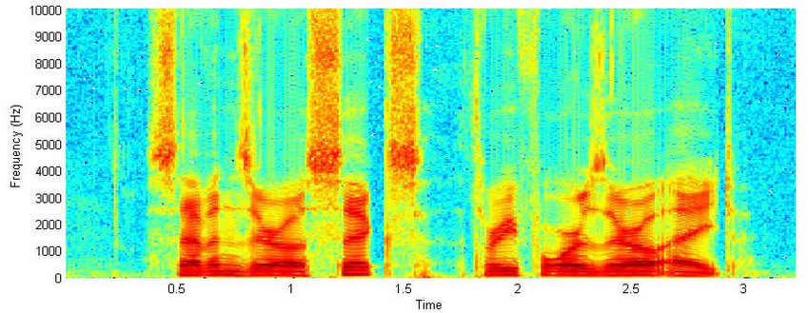
DATA PREPROCESSING
Loading and Parsing Audio Files:
Utilised librosa and torchaudio for feature extraction.
Parsed filenames to extract metadata.
Mel Spectrogram Transformation:
Explanation: Mel spectrograms represent the power spectrum of sound on a mel scale.
Usage: Mimic human ear perception; provide a visual representation for CNNs.
Data Augmentation Techniques:
Time Shift: Introduces variability by shifting audio signals.
Adding Noise: Adds robustness by incorporating random noise.

Slide 11
MODEL ARCHITECTURE
Description of the CNN Model:
Processes mel spectrograms for emotion classification.
Layers Used:
Convolutional Layers: Detect local patterns in spectrograms.
Pooling Layers: Reduce data dimensionality while retaining features.
Fully Connected Layers: Perform the final classification.
Why CNN Was Chosen:
Effective for Spatial Data: Captures spatial hierarchies.
Suitable for Spectrogram Analysis: Ideal for processing 2D spectrograms.

Slide 12
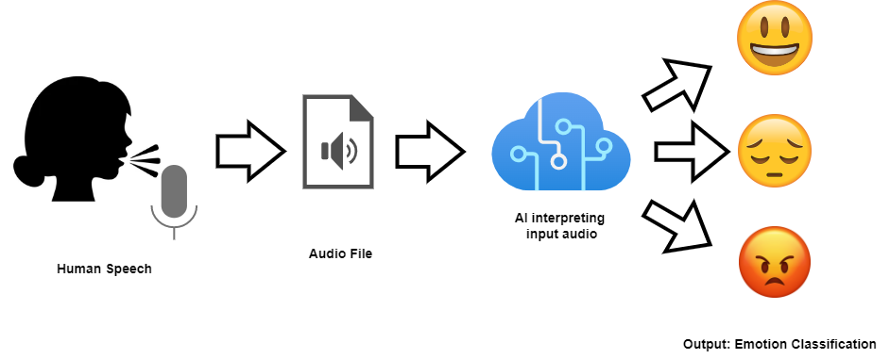

Slide 13
Training Process and Model Evaluation
05

Slide 14
TRAINING PROCESS
Training/Testing Split: 80:20 ratio to ensure a balanced evaluation.
Batch Size and Number of Epochs: Batch size of 32 and 20 epochs for training.
Loss Function and Optimizer:
Cross-Entropy Loss
Adam Optimizer (Adaptive moment estimation)
Early Stopping Criteria: Stops training after 3 epochs without improvement to prevent overfitting.
Use of TensorBoard: Logs and visualises training metrics for monitoring progress.

Slide 15
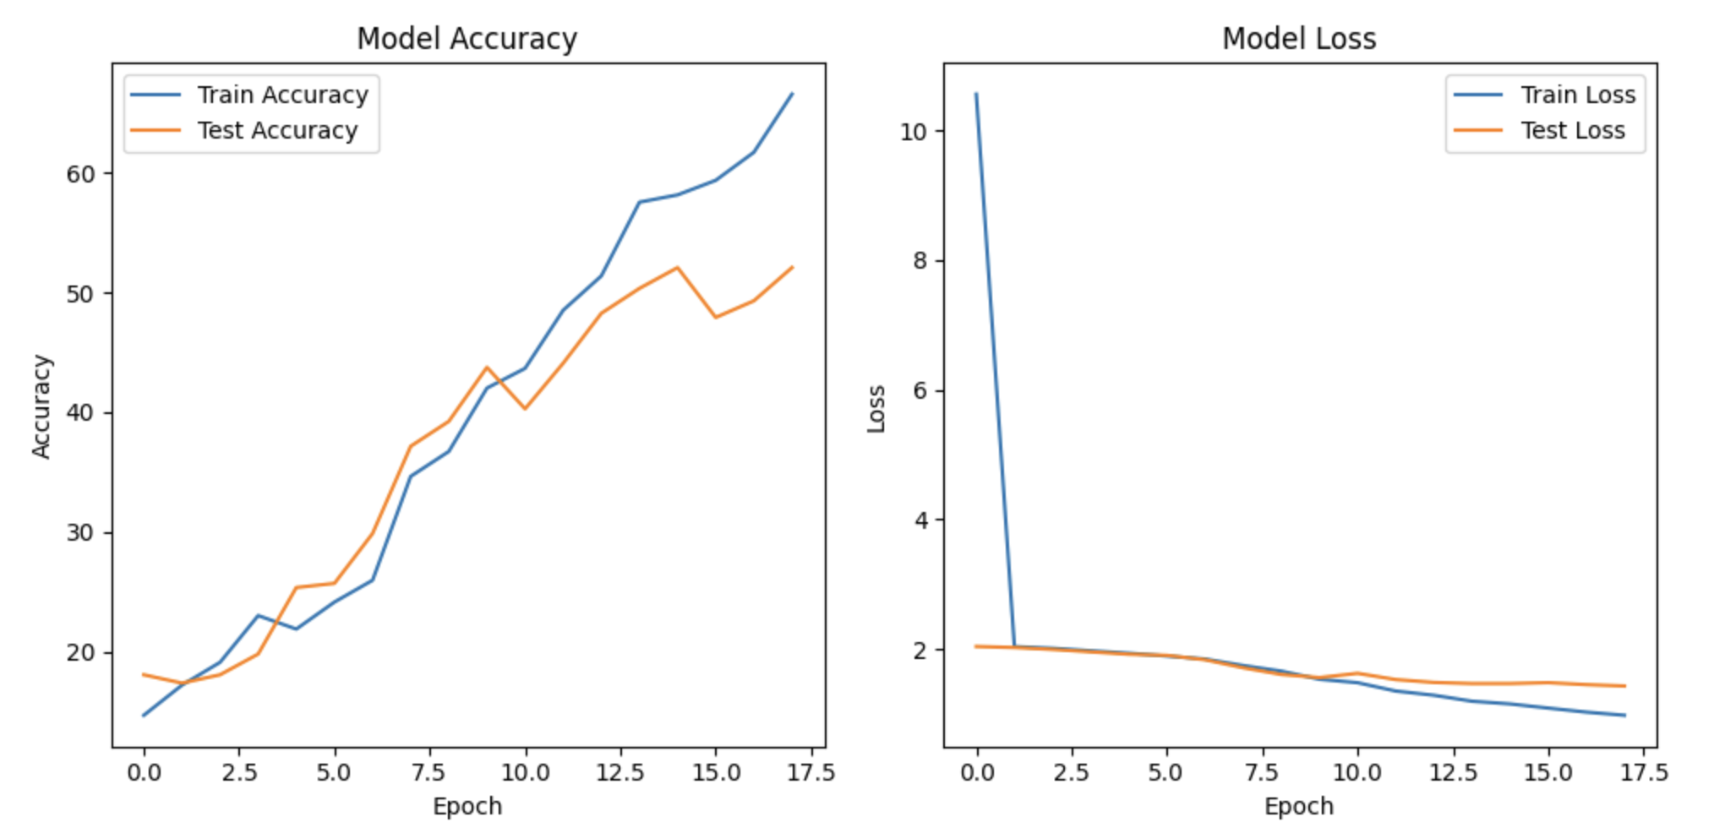

Slide 16
MODEL EVALUATION
Evaluation Metrics: Primarily used accuracy to measure performance.
Training and Testing Accuracy: Monitored to assess generalisation.
Discussion on Model Performance:
Strengths: High accuracy for certain emotions, robustness due to data augmentation.
Areas for Improvement: Increase dataset size, improve feature extraction, address misclassifications.

Slide 17
Conclusion
06

Slide 18
Impact and Applications:
Customer Service: Enhanced user interactions.
Healthcare: Assist in mental health monitoring.
Entertainment: Emotionally aware virtual assistants and games.
Education: Adaptive learning environments.
Final Thoughts:
Deep learning's potential in emotion understanding.
Future systems can be more empathetic and intelligent.

Slide 19
Thank you !

